Slide 1
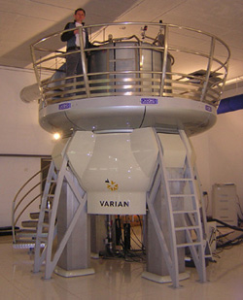
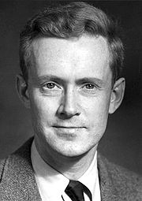
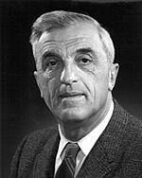
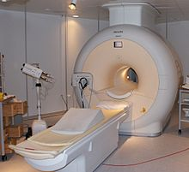
900MHZ NMR at HWB
Birmingham UK
Edward Mills Purcell (August 30, 1912 – March 7, 1997) was an American Physicist, Nobel Prize in Physics 1952.
SECTION II (CHAP. 16)
NUCLEAR MAGNETIC RESONANCE SPECTROSCOPY
MRI
Felix Bloch (October 23, 1905 – September 10, 1983) was a Swiss Physicist, working mainly in the U.S., Nobel Prize in Physics 1952.

Slide 2
FUNDAMENTAL CONCEPTS
The principle of NMR
Chemical shift
The current effect
NMR signals
Symmetry and topicity
Spin-spin coupling
Structure elucidation
Basic principle of ¹³C-NMR
Basic principle of MRI

Slide 3
THE DISCOVERY OF THE NMR
Around 1946, two research groups (Bloch’s and Purcell’s) independently observed nuclear resonance signals for the first time, and they were jointly awarded the Nobel Prize for Physics in 1952 for their discovery.
During the first three decades of NMR spectroscopy all measurements relied on one-dimensional modes until the development of two-dimensional NMR experiments during the 1970s.
Recently it has even become possible to perform experiments with three or more dimensions, although these are far from being routine techniques.
The importance of the position that NMR spectroscopy now occupies can be illustrated by the awards of Nobel Prizes
In Chemistry in 1991 to R. R. Ernst and in 2002 to K. Wüthrich for their pioneering research on NMR methods in chemistry and biochemistry
In Medicine in 2003 to L. Lauterbur and P. Mansfield for their pioneering research on NMR methods in medicine

Slide 4


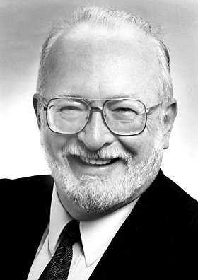
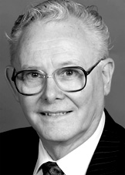
THE IMPORTANCE OF THE NMR
Kurt Wüthrich (born October 4, 1938) Swiss chemist and biophysicist and 2002 Nobel Prize winner for developing NMR methods for studying biological macromolecules.
Richard Robert Ernst (born August 14, 1933) Swiss physical chemist and 1991 Nobel Prize in Chemistry for his contributions towards the development of Fourier Transform NMR.
Sir Peter Mansfield (born 9 October 1933), is a British physicist and 2003 Nobel Prize winner for discovering the MRI.
Paul Christian Lauterbur (May 6 1929 - March 27, 2007) was an American chemist and 2003 Nobel Prize winner in medicine for his pioneer work that led to the development of MRI.

Slide 5
BASIC PRINCIPLE OF NMR
The elucidation of the structure of molecules remains one of the main field of application of NMR spectroscopy.
Every nucleus carries some charge, and in some of them this charge “spins” around the nuclear axis. This spinning generates a magnetic dipole and the angular momentum of the spinning charge known as the spin number I = 0, ½ , 1 or ³/₂.
The spin number of a given nucleus can be determined from the atomic mass and the atomic number
The spectra of several nuclei can easily be obtained because they have a spin number of ½ and a uniform spherical charge distribution. The most explored are:
Spin number (I) | Atomic mass | Atomic number | Example
Half-integer | Odd | Odd or even | ¹H(½), ¹⁵O(⁵/₂) or ¹⁵N(½)
Integer | Even | Odd | ²H(1), ¹⁴N(1), ¹⁰B(3)
Zero | Even | Even | ¹²C(0), ¹⁶O(0), ³⁴S(0)

Slide 6
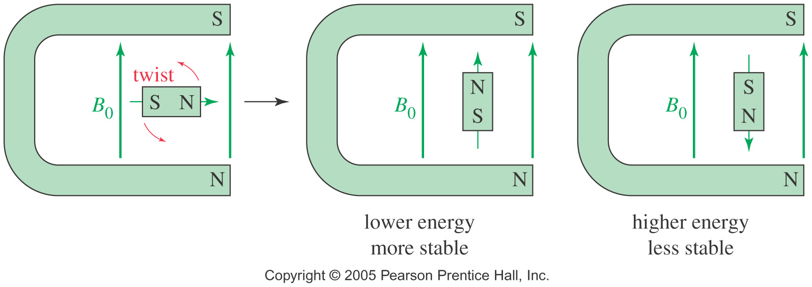
BASIC PRINCIPLE OF NMR
External Magnetic Field
When a small bar magnet is placed in the field of a larger magnet, it twists to align itself with the field of the larger magnet.
When placed in an external field, spinning protons act like bar magnets
Quantum mechanics requires the proton’s magnetic moment to be aligned either with the external field or against the field.

Slide 7
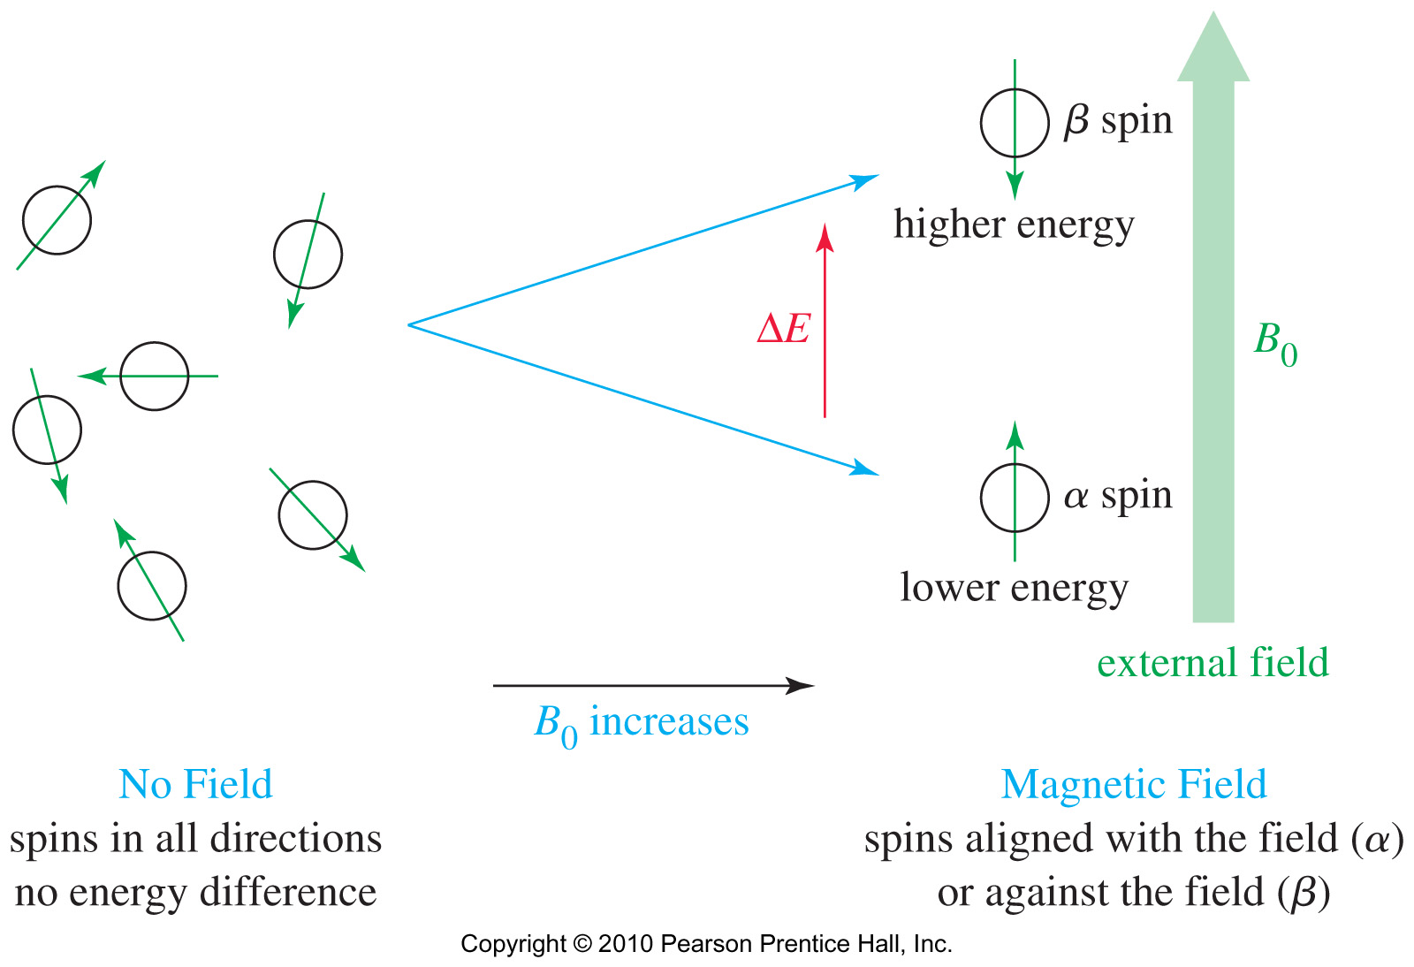
BASIC PRINCIPLE OF NMR
Nuclei with a spin number I of 1 or greater have a non-spherical charge distribution, and this asymmetry described by an electrical quadrupole moment affects the relaxation time, and thus the linewidth as well as the coupling with neighboring nuclei.
In quantum mechanical terms, the spin number determines the number of orientations in accordance with the formula 2I + 1.
As such, nuclei with a spin number of ½ will have only 2 possible orientations corresponding to two energy levels, with a slight excess population in the lower energy level (Nα > Nβ) in accordance with the Boltzmann.
-½
½

Slide 8
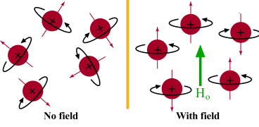
BASIC PRINCIPLE OF NMR
Proton Magnetic Moments
Radio-frequency (RF) electromagnetic radiation is the type of energy used in the NMR instrument for irradiation. Polarized RF is therefore a polarized light even though its frequency is too low for us to be seen or (normally) feel. It has all its magnetic field components lined up along the same axis.
This perturbation of the equilibrium distribution of state populations is called excitation
The excited nuclei emit a magnetic signal called a free induction decay (FID) that can be detected with appropriate electronics and capture digitally.
The digitized FID(s) can be process by using computational methods to provide the NMR spectrum.

Slide 9
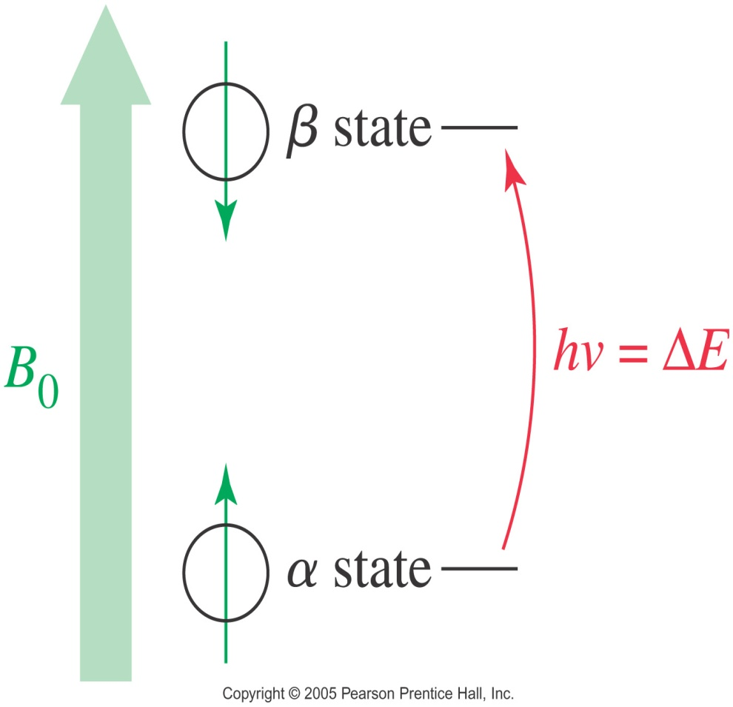
BASIC PRINCIPLE OF NMR
Energy difference is proportional to the magnetic field strength.
ΔE = hν = γ h B₀ 2π
The fundamental NMR equation correlating the applied radiofrequency ν₁ with the magnetic field strength is:
ν_{L} = ν₁ = (γ/2π) Bo
where ν_{L} is the precession frequency also known as Larmor frequency, given in MHz
ΔE = energy difference between α and β states
h = Planck’s constant
Bo = strength of the external magnetic field
γ = gyromagnetic ratio, which is a constant for each nucleus (26,753 s⁻¹gauss⁻¹ for H).

Slide 10
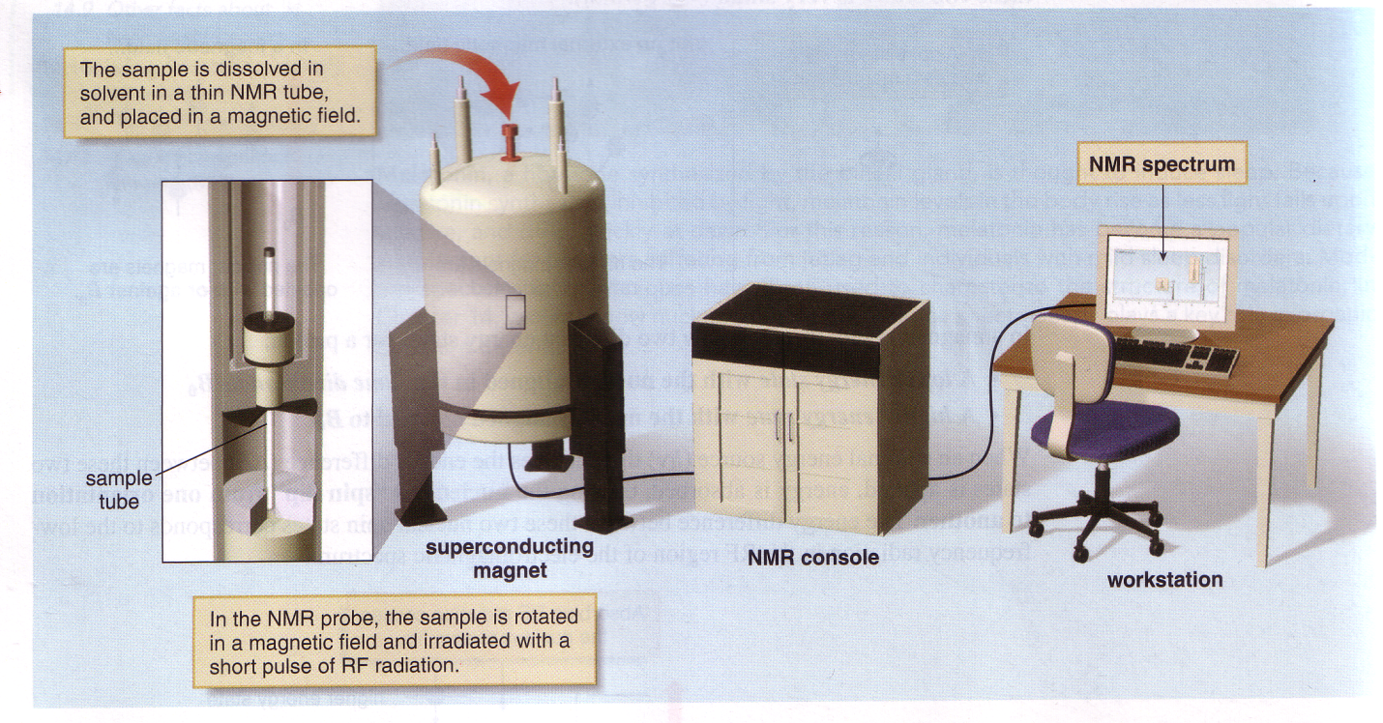
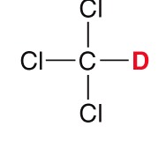
BASIC PRINCIPLE OF NMR

Slide 11
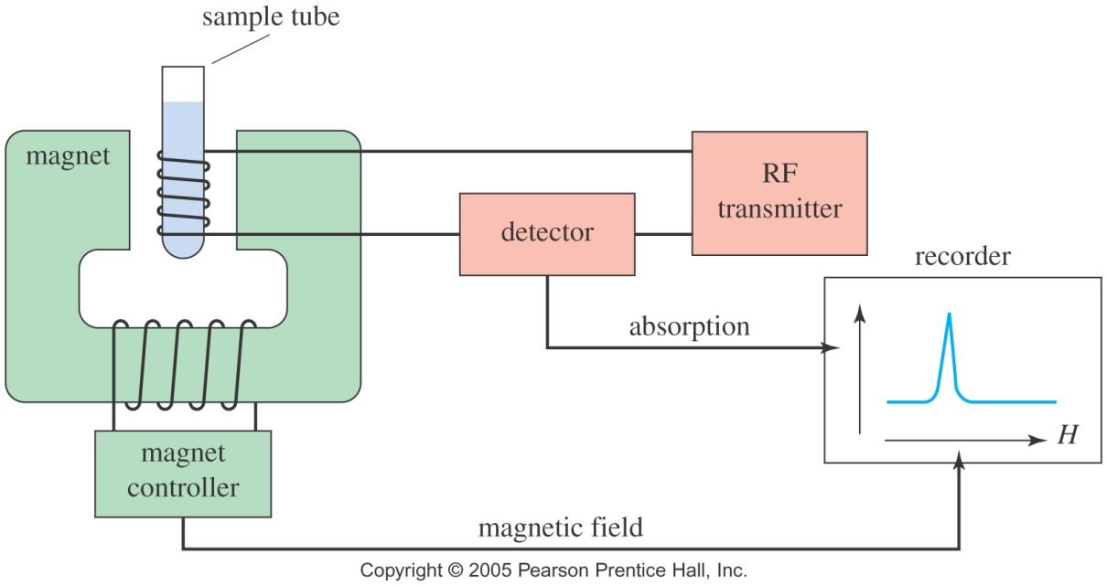
BASIC PRINCIPLE OF NMR
The NMR Spectrometer
For ¹H-NMR, 2 to 4 mg of sample in 0.4 mL of solvent (4 to 5 cm in an NMR tube) is enough. However, since a sample is usually used for a wide range of experiments including ¹³C-NMR, 20 to 30 mg of sample in 0.4 mL is preferred.
The ideal solvent for NMR samples must not contain an highly abundant atomic isotope with an active nucleus such as ¹H, ¹⁹F or ³¹P that could overshadow the signals from the sample, should be inert, have low boiling point and inexpensive. So, carbon tetrachloride CCl₄ was used initially.
However, since pulsed instruments depend on deuterium in the field-frequency lock, deuterated solvents such as chloroform-d (CDCl₃), acetone-d₆ (CD₃COCD₃), and dimethyl sulfoxide-d₆ (CD₃SOCD₃) are preferred, and a wide range of deuterated solvents are also available for NMR.

Slide 12
THE CHEMICAL SHIFT
Based on the fundamental NMR relationship shown below, all protons will absorb the same amount of energy in a given magnetic field, and only a single signal should be expected from the interaction of the rf energy and a strong magnetic field for each nuclear species, a situation that would have made this technique useless to chemists.
ν_{L} = ν₁ = (γ/2π) Bo
But fortunately, resonances are influenced in characteristic ways by the environment of the observed nuclei, as protons are surrounded by electrons that shield them to a very small extent from the external field.
Circulating electrons create an induced magnetic field that opposes the external magnetic field, and this effect accounts for the diamagnetism exhibited by all organic material.
The net result is that at a given value of Bo, the effective frequency at resonance (ν_{eff}) is less than the rf applied (ν₁), and thus the nucleus is said to be shielded.

Slide 13
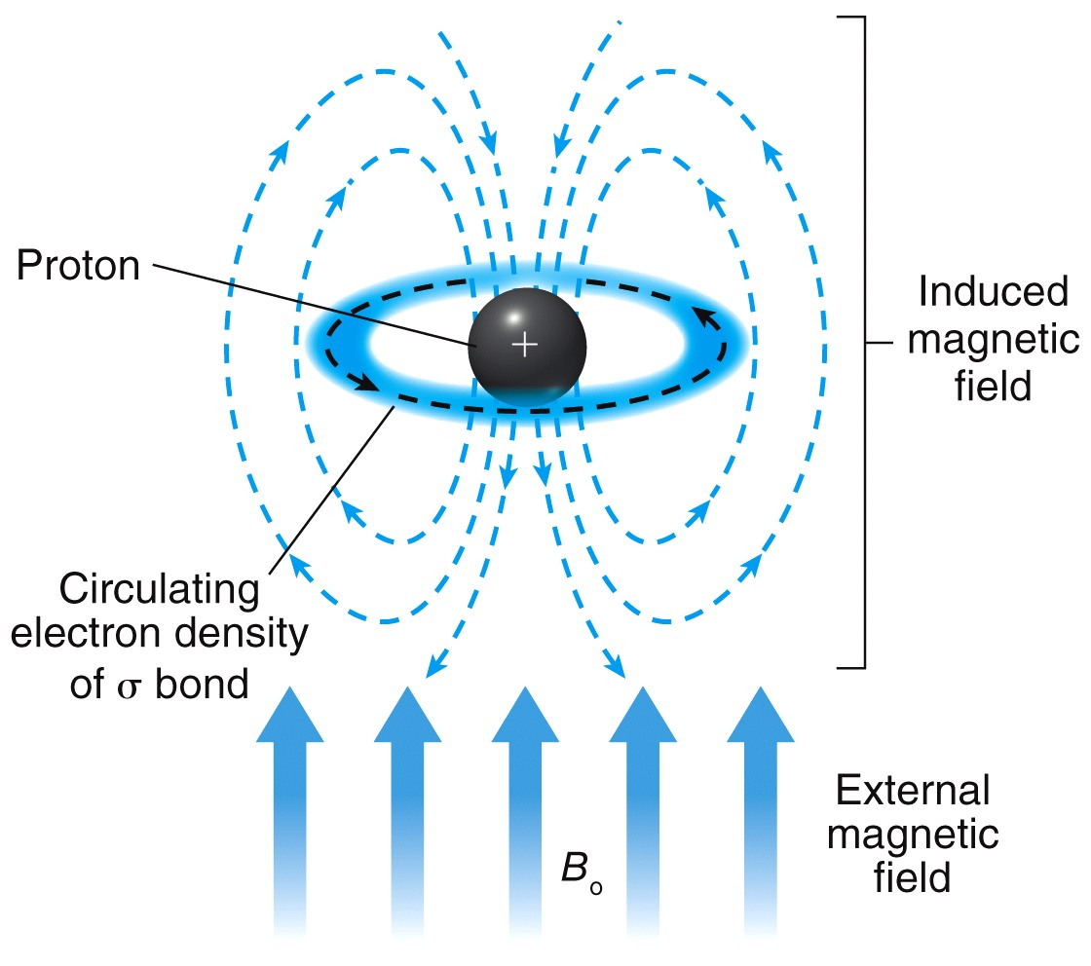
THE CHEMICAL SHIFT
Magnetic Shielding
ν_{eff} = γ/2π (1 – σ) Bo, where σ is the shielding constant
Thus, B_{effective} = (1 – σ) B_{external}
The degree of shielding depends on the density of the circulating electrons.
The shielding constant increases proportionally with the electronegativity of the surrounding atoms, and roughly depends on the inductive and mesomeric effects of the electron density.
The chemical shift is the difference in the absorption position of a particular proton from the absorption position of a reference proton.

Slide 14
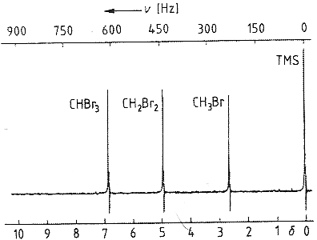
THE CHEMICAL SHIFT
Magnetic Shielding
Nuclei that are in different chemical environments will have different shielding constant. They will be shielded to different extents, and thus will be chemically non-equivalent. So, they will give separate signals in the spectrum.
For example: σ (CHBr₃) < σ (CH₂Br₂) < σ (CH₃Br) < σ (TMS)
So, shielded proton appears at a lower frequencies
In accordance with a universal convention, resonance signals in NMR spectroscopy are recorded in such a way that the shielding constant σ increase from left to right.
TMS = Tetramethylsilane

Slide 15
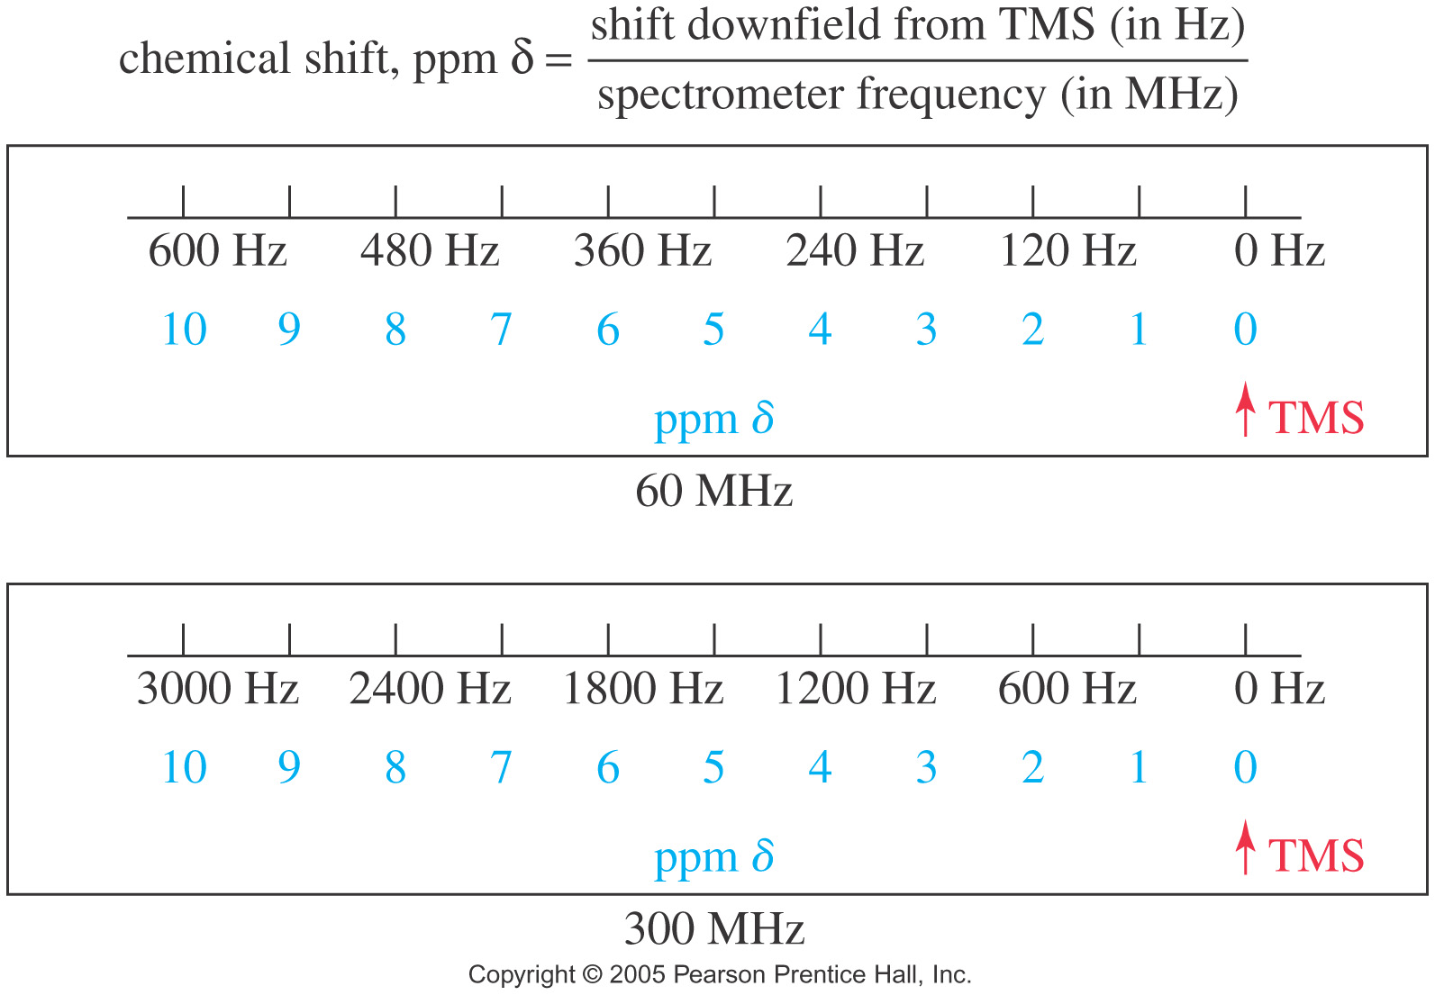
THE CHEMICAL SHIFT
Since different NMR apparatus could have different magnetic flux density Bo, the resonance frequency will vary from one equipment to another, as the resonance frequency and the magnetic flux density are interdependent.
The relative scale is thus depending on the external field, and varies from one NMR apparatus to another.
To solve this problem, the absolute scale (δ scale) was introduced by IUPAC.
δ_{sample} = (ν_{sample} – ν_{reference})/ν_{reference} = Δν(Hz)/ν_{reference} (MHz)
δ is then a quantity without unit, but with a 10⁻⁶ constant factor that was name “ppm” (part per millions)

Slide 16
THE CHEMICAL SHIFT
Examples
1. A 90 MHz spectrometer records the protons of CHBr₃, CH₂Br₂, and CH₃Br that absorb at 614, 441 and 237 Hz downfield from TMS. Determine their chemical shifts in ppm.
2. A 500 MHz spectrometer records protons that absorb at 2130, 2046, 1470 and 789 Hz downfield from TMS.
Determine their chemical shift in ppm.
(b) Predict these proton’s chemical shift in ppm if a 300 MHz spectrometer was used instead.
(c) In a 300 MHz spectrometer, how far downfield (in hertz) from TMS would this proton absorb?

Slide 17
THE CHEMICAL SHIFT

Slide 18
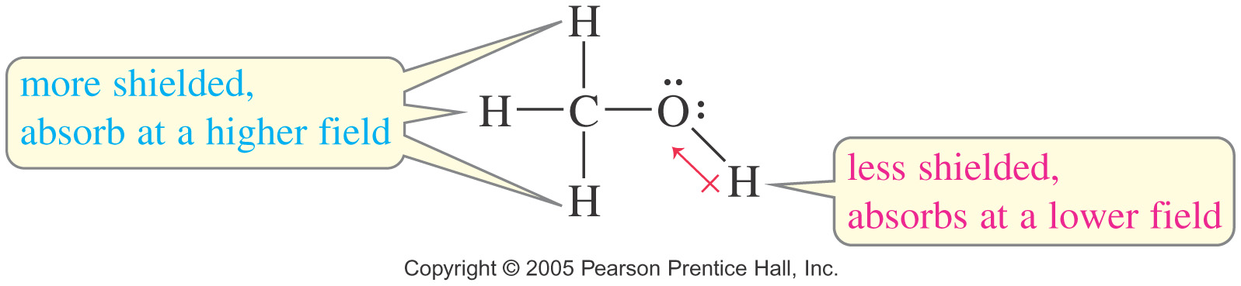
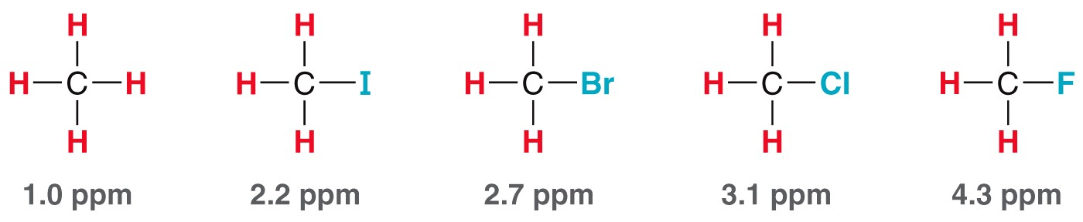
THE CHEMICAL SHIFT
So, by definition, the chemical shift is the difference (in parts per million; ppm) between the resonance frequency of the nuclear spin being observed and that of tetramethylsilane (TMS).
Depending on their chemical environment, protons in a molecule are shielded by different amounts.
For example the hydroxyl is not as shielded as much as the methyl protons, so the hydroxyl proton absorbs at lower field than the methyl protons.
The hydroxyl proton is said to be deshielded somewhat by the presence of the electronegative oxygen atom.

Slide 19
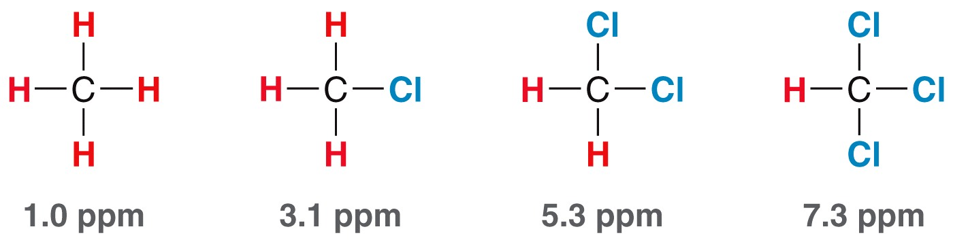
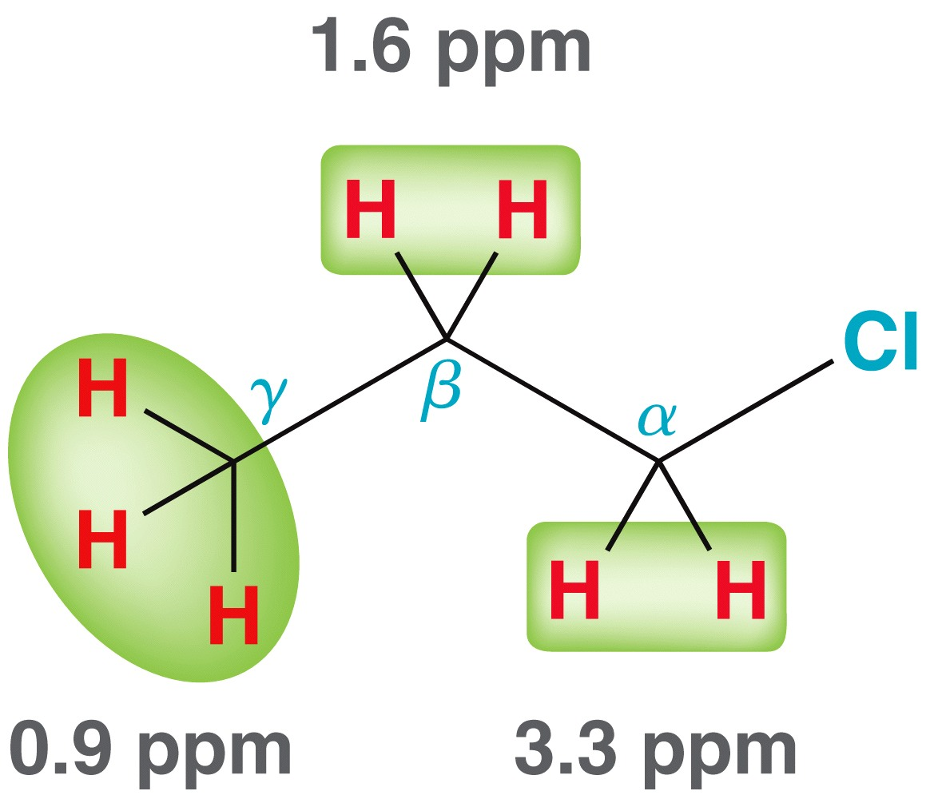
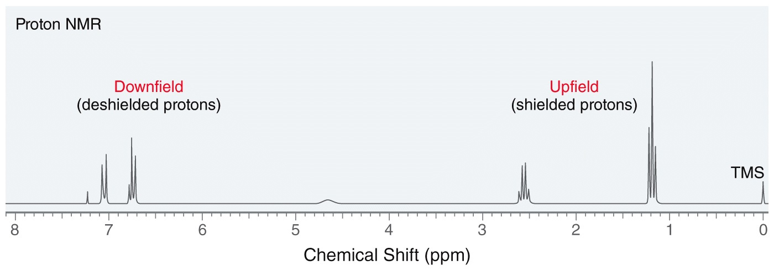
THE CHEMICAL SHIFT
Effects of Neighboring groups
More electronegative atoms deshield more and give larger shift values.
Effect decreases with distance.
Additional electronegative atoms cause increase in chemical shift.
Higher Energy
Lower Energy

Slide 20
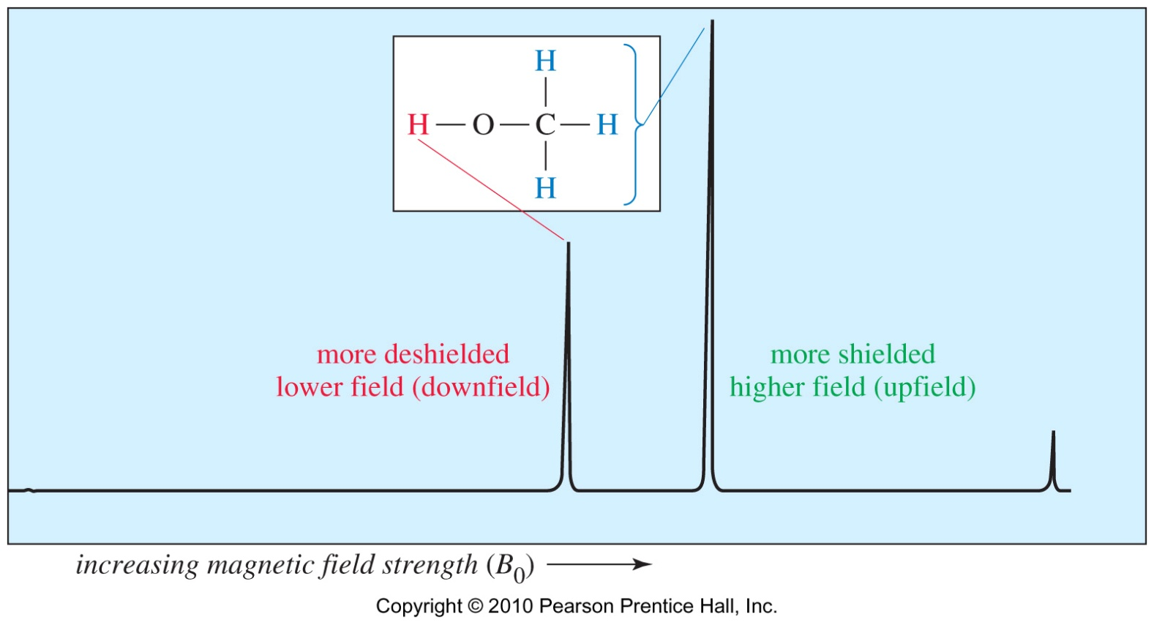
THE CHEMICAL SHIFT
upfield
downfield
NMR Signals
The number of signals shows how many different kinds of protons are present.
The location of the signals shows how shielded or deshielded the proton is.
The intensity of the signal shows the number of protons of that type.
Signal splitting shows the number of protons on adjacent atoms

Slide 21
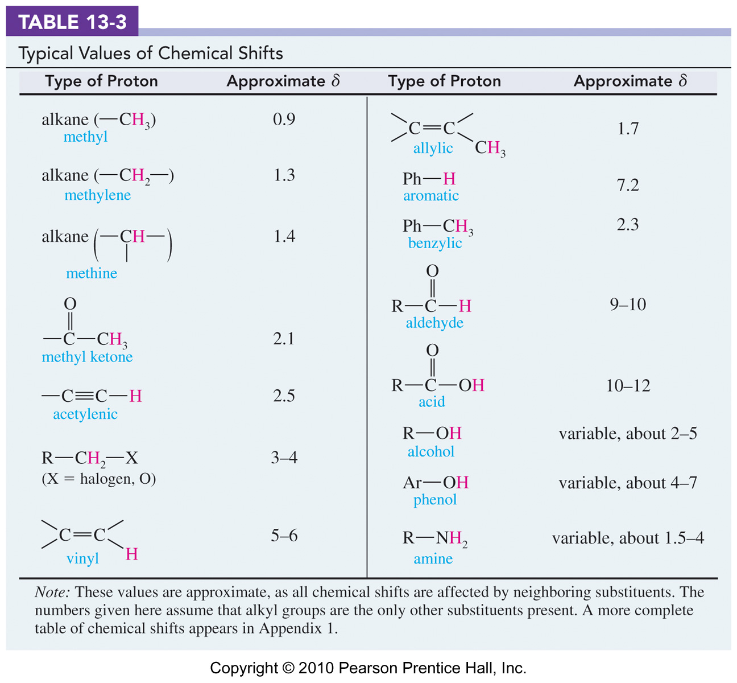
THE CHEMICAL SHIFT

Slide 22
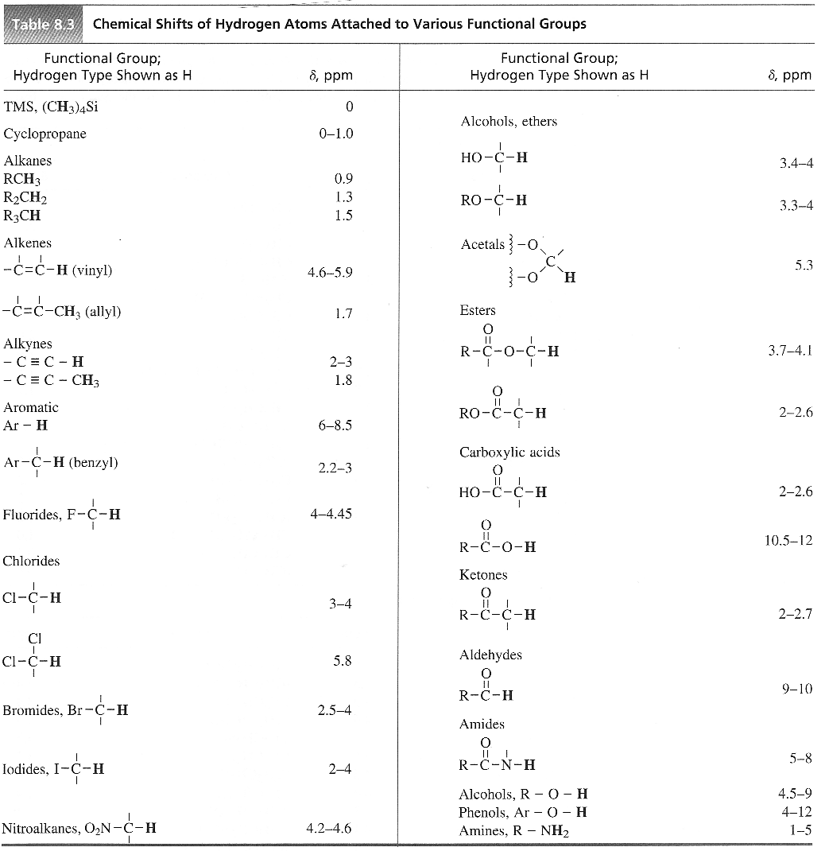
THE CHEMICAL SHIFT

Slide 23
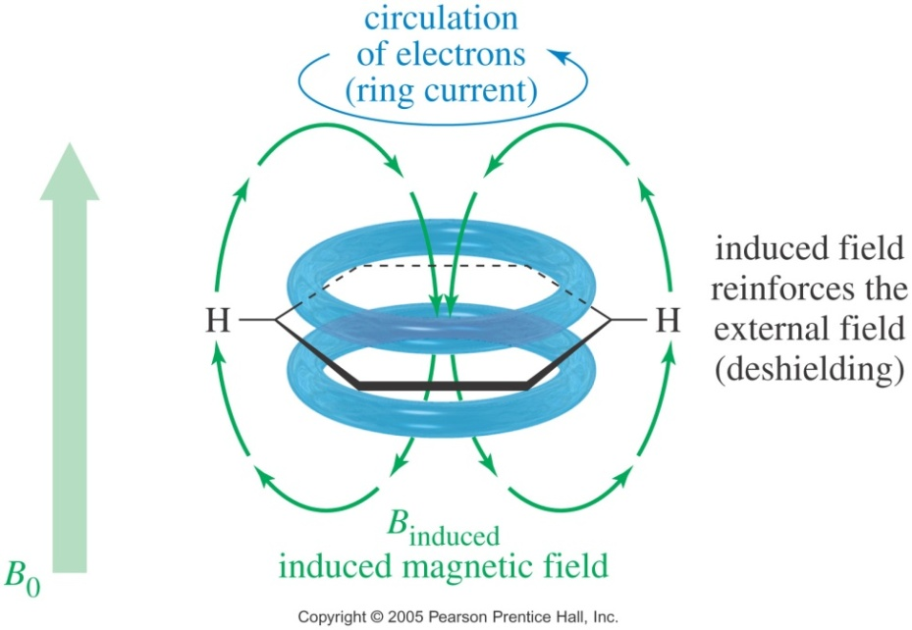
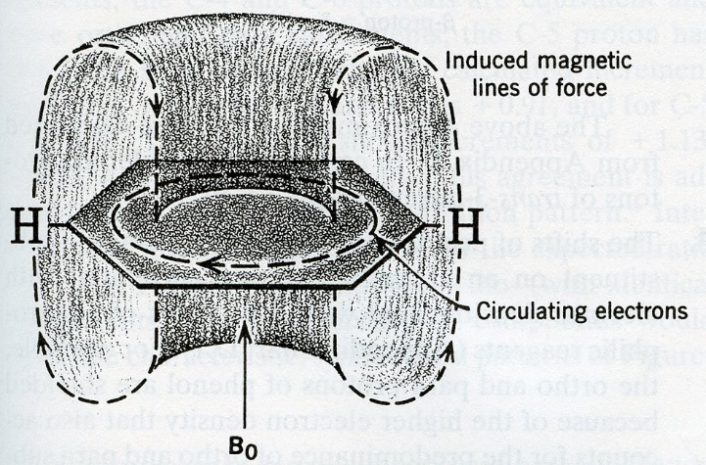
Aromatic Protons, δ7-8 ppm
THE CHEMICAL SHIFT
The ring current effect
Since the pi bond of alkene deshields the vinyl protons, one might expect an acetylenic hydrogen to be even more deshielded by the two pi bonds of the triple bond than that of the double bond, but that’s not the case.
Moreover, the aromatic rings produce large deshielding effects on their aromatic protons that appear around 7 ppm instead of 5-6 ppm as any vinylic protons.
These deshielding effects result from the same type of circulation of electrons and are called a ring current effect.

Slide 24
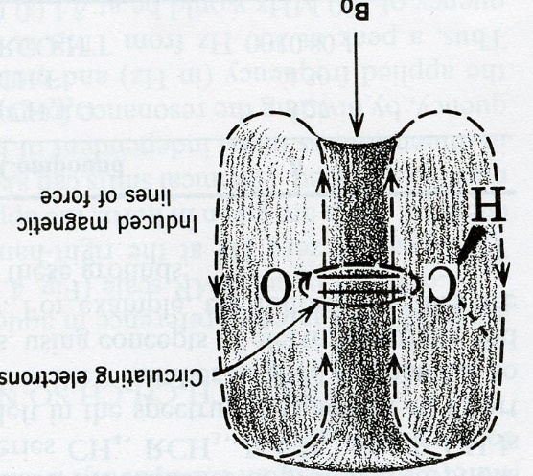
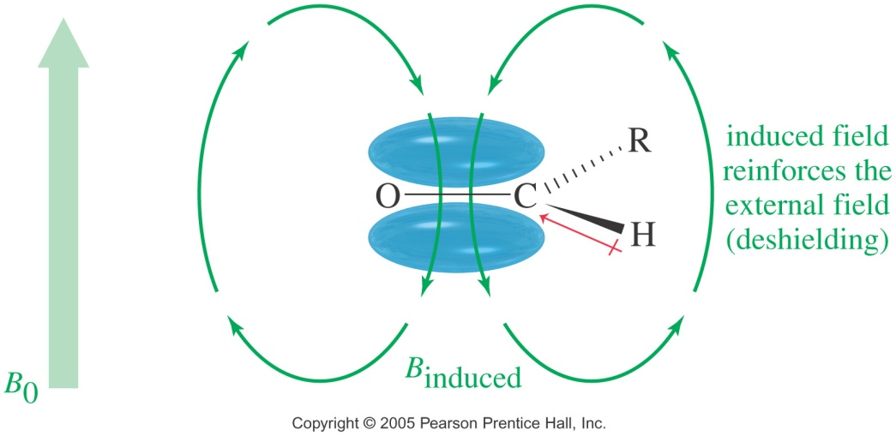
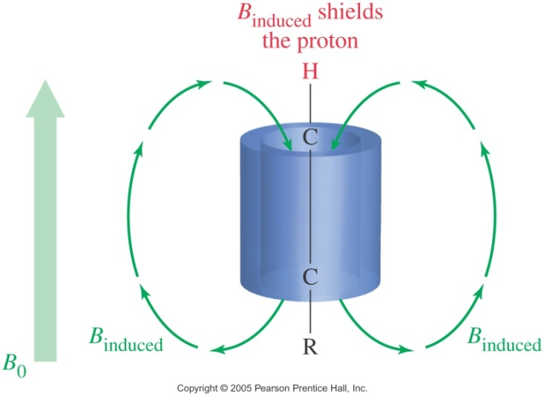
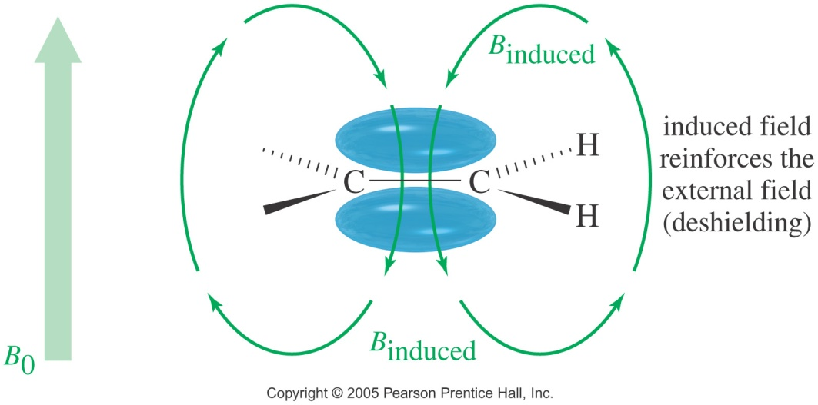
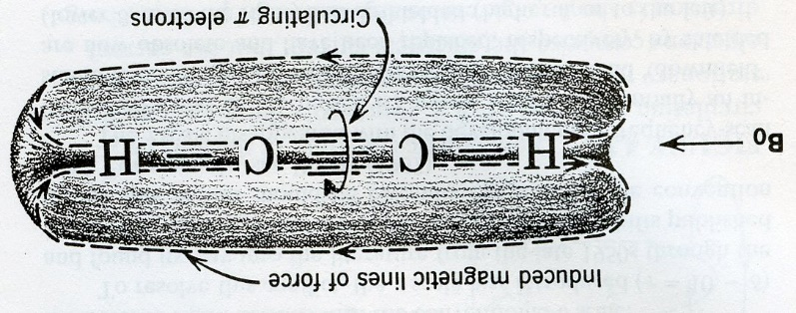
Acetylenic Protons, δ2.5 ppm
THE CHEMICAL SHIFT
The ring current effect
Aldehyde Proton, δ9-10 ppm
Vinyl Protons, δ 5-6 ppm

Slide 25
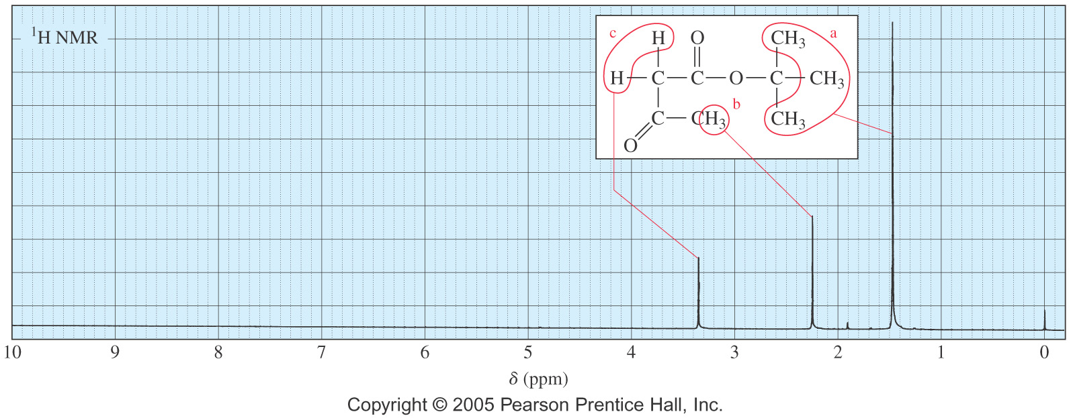
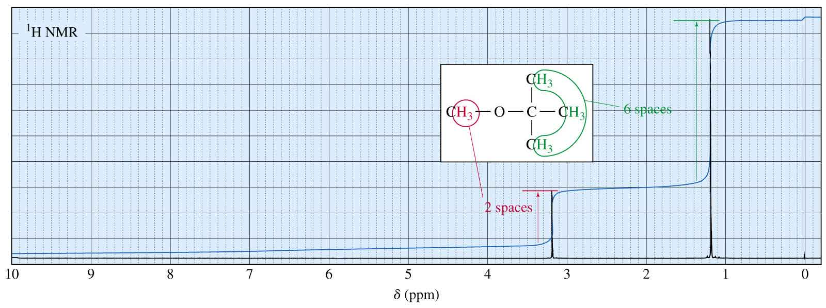
NMR SIGNALS
Equivalent hydrogens have the same chemical shift
The area under each peak is proportional to the number of protons, and shown by integral trace

Slide 26
NMR SIGNALS
Examples
Predict the number of signals expected and their approximate chemical shifts (disregarding splitting) in the ¹H-NMR spectrum of the following compounds
Practice 16.4, 16.5 P. 742, 16.7 to 16.9 P. 747, 16.10 P. 749
Problem 16.34 P. 776, 16.48 P. 777

Slide 27
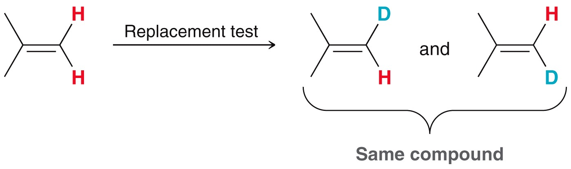
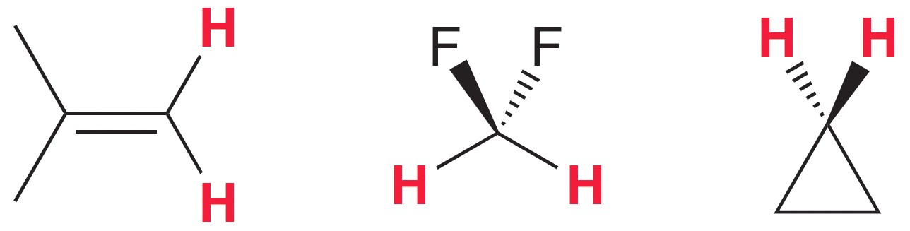
SYMMETRY AND TOPICITY
Homotopicity
Two protons are said to be homotopic if, by marking only one atom or group (by isotopic substitution; substitute ²H for ¹H), we produce the exact same molecule regardless of which ¹H is marked. They are also said to be chemically equivalent.

Slide 28
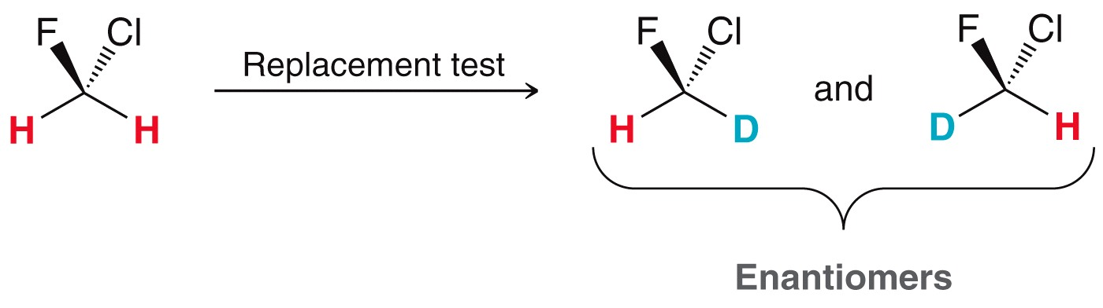
SYMMETRY AND TOPICITY
Enantiotopicity
Two atoms or groups are said to be enantiotopic if labeling one of these groups (or atoms) produces a molecule that is mirror image (enantiomer) of the molecule produced when the other atom or group is labeled.
One of these atoms or group is Pro-R while the other one is Pro-S.
The resonances of NMR-active enantiotopic groups or atoms will be isochronous in the absence of any chirality in the molecule

Slide 29
SYMMETRY AND TOPICITY
Diastereotopicity
Two atoms or groups are said to be diastereotopic if the two atoms or groups appear to be related by symmetry, but the isotopic labeling of one of the two atoms or groups produces a different molecule that cannot be superimposed on the molecule produced when the other group or atom is labeled (diastereomer).
The resonances of NMR-active diastereotopic groups or atoms will be isochronous if the stereogenic (s) center present in the molecule is very far from these atoms or groups.
Magnetic equivalence (quite rare because its definition is too restrictive)
Two atoms are said to be magnetically equivalent if they have the exact same geometrical relationship to every NMR-active atom in the molecule.

Slide 30
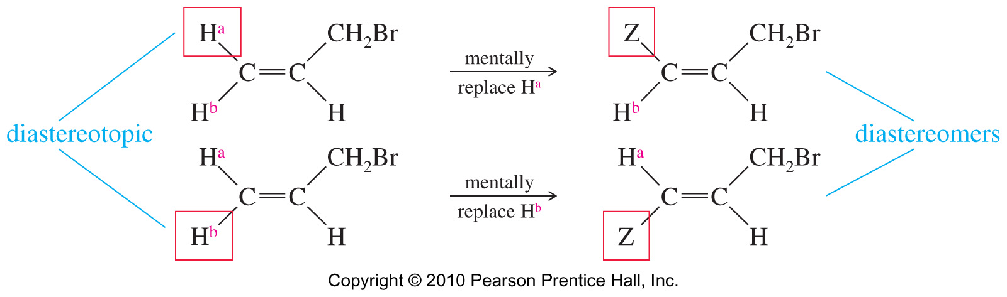
SYMMETRY AND TOPICITY
Diastereotopicity
Replacing the cis hydrogen gives the cis diastereomer, and replacing the trans hydrogen makes the trans diastereomer.
Because the two imaginary products are diastereomers, these protons are called diastereotopic protons.
Diastereotopic hydrogens are capable of splitting each other
Problem 16.40 P. 776

Slide 31
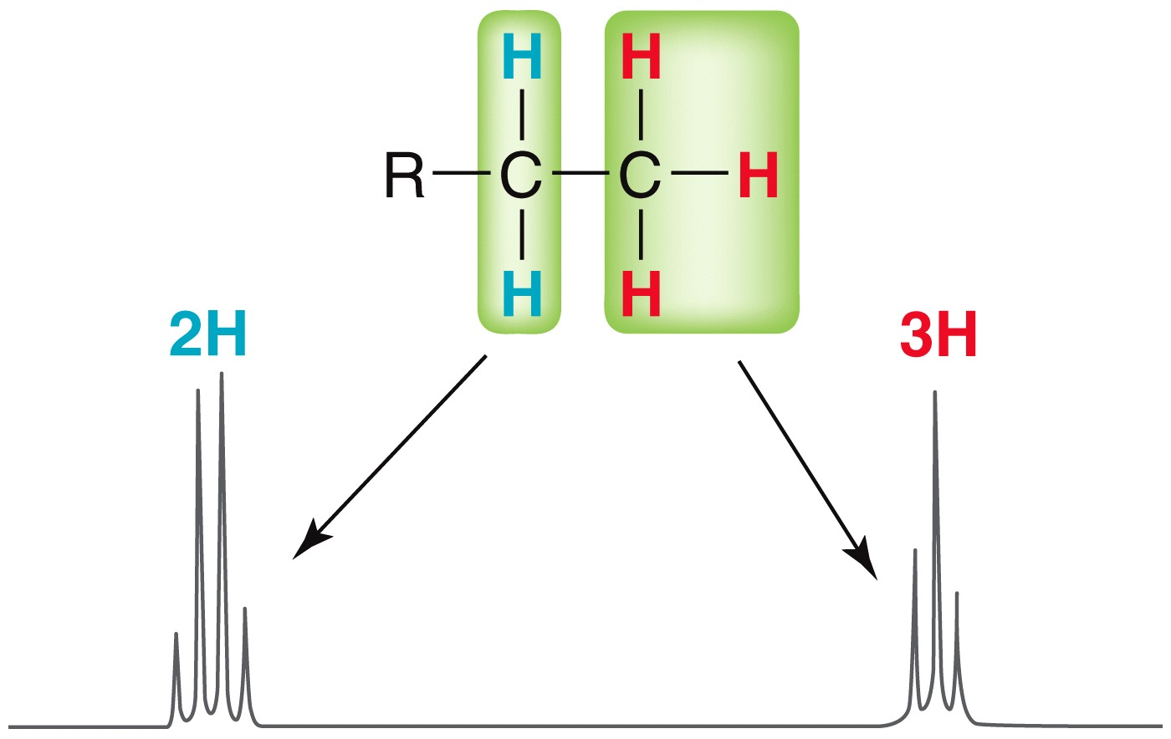
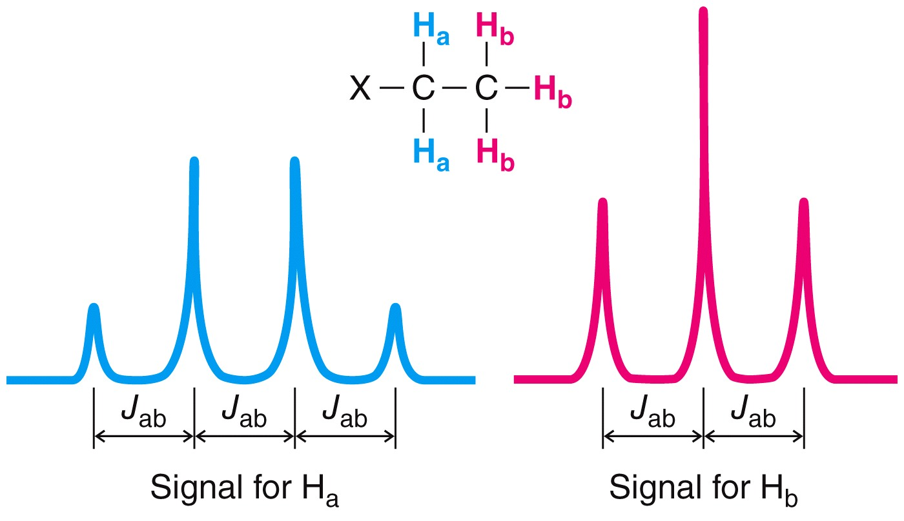
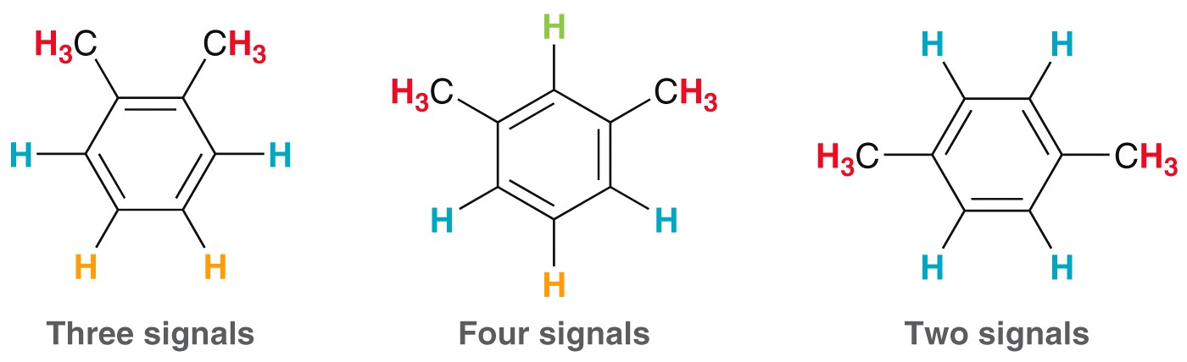
SPIN-SPIN COUPLING
Nonequivalent protons on adjacent carbons have magnetic fields that may align with or oppose the external field. This magnetic coupling causes the proton to absorb slightly downfield when the external field is reinforced and slightly upfield when the external field is opposed. Since all these possibilities exist, signal is split.
The N + 1 Rule (n is the number of adjacent protons)

Slide 32
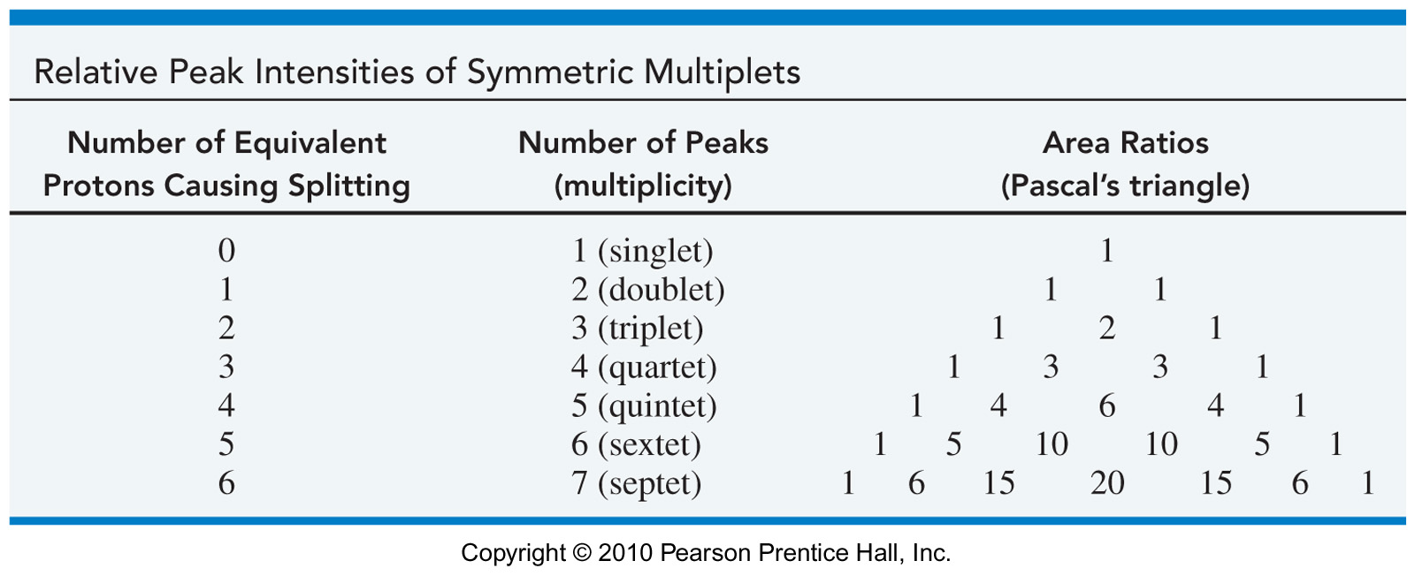
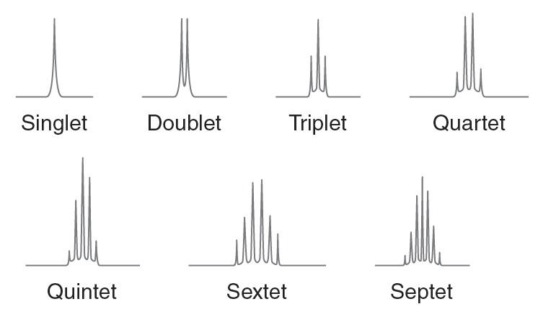
SPIN-SPIN COUPLING
If a proton has N equivalent protons on adjacent carbons, it is split into N + 1 peaks

Slide 33
SPIN-SPIN COUPLING
First-order spin systems
1 neighbor (α and β state) = 1:1 (2 signals, doublets)
2 neighbors (αα; αβ; βα and ββ) = 1:2:1 (3 signals, triplet)

Slide 34
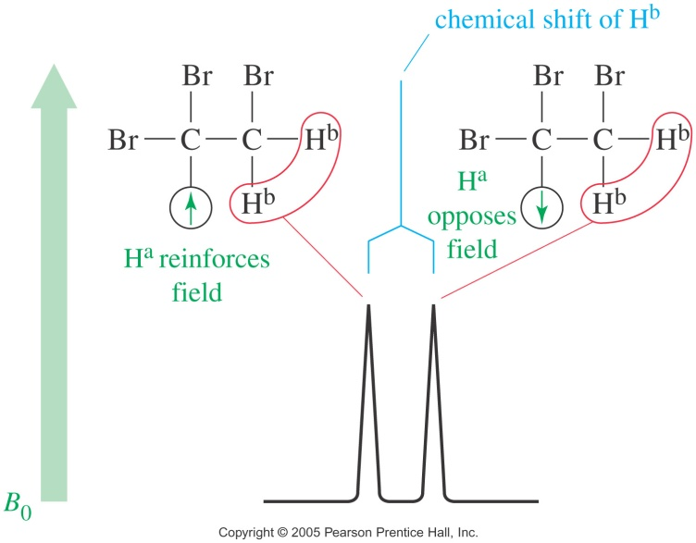
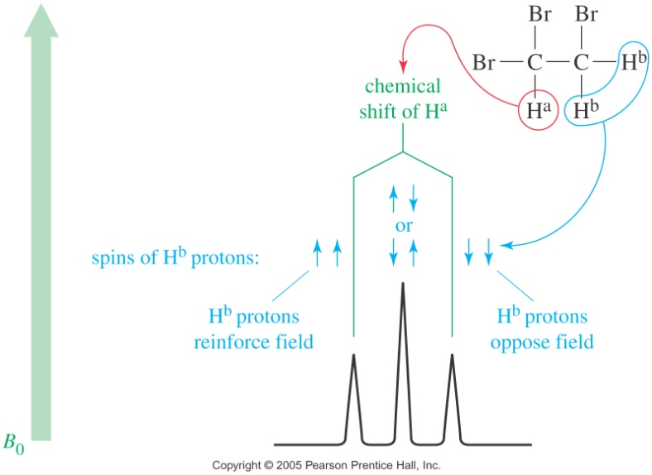
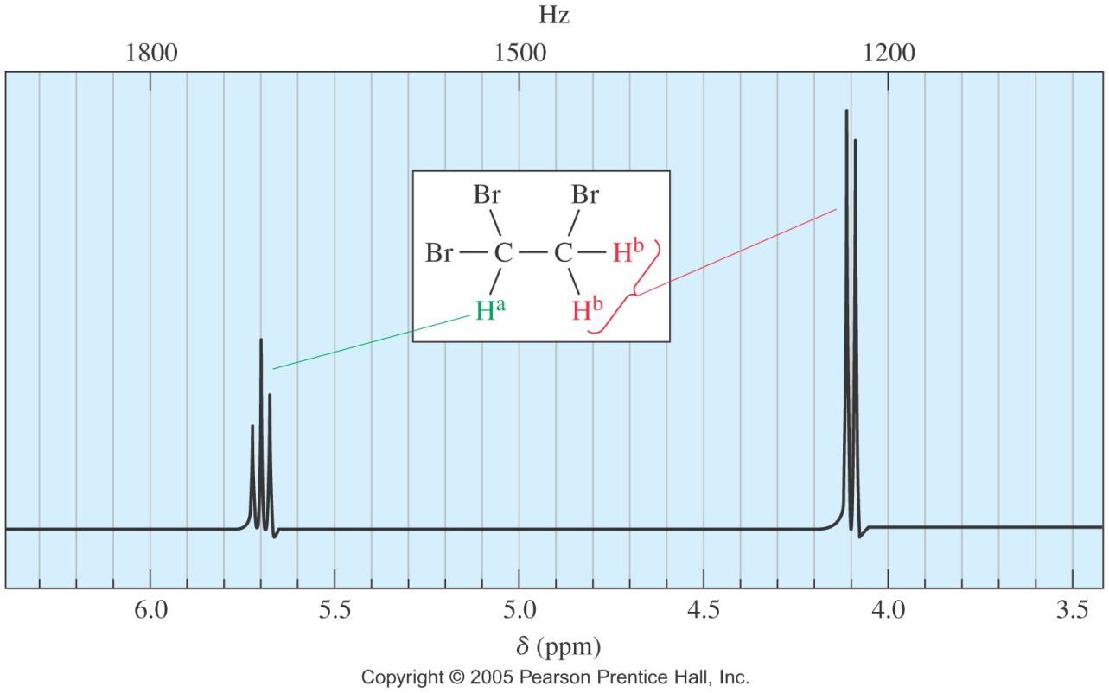
SPIN-SPIN COUPLING

Slide 35
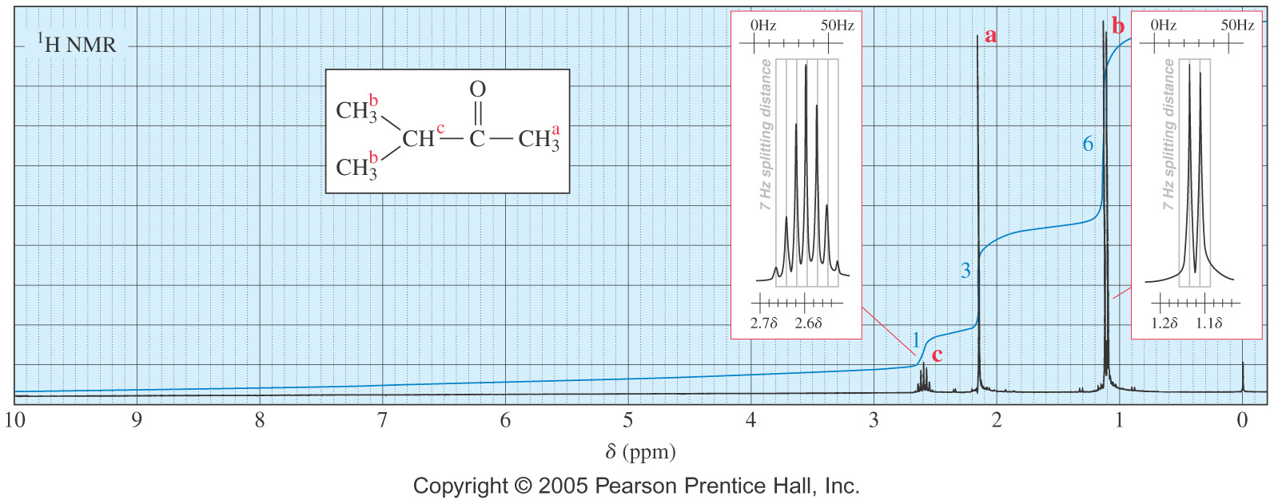
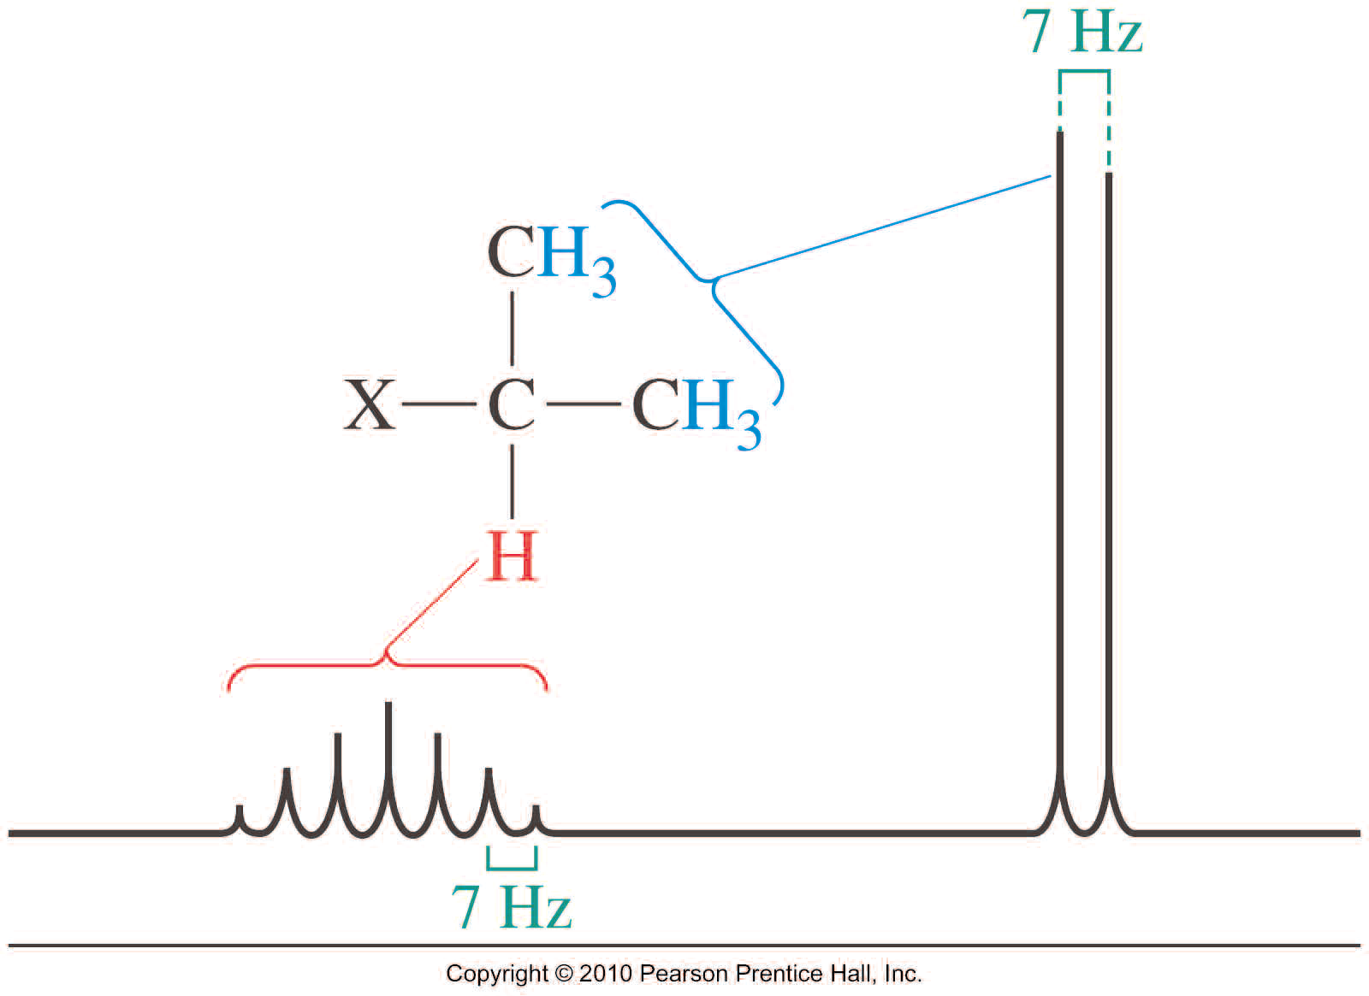
SPIN-SPIN COUPLING
In the absence of Dach effects, we can predict the appearance of multiplets by counting the number of nearby NMR-active spins.

Slide 36
SPIN-SPIN COUPLING

Slide 37
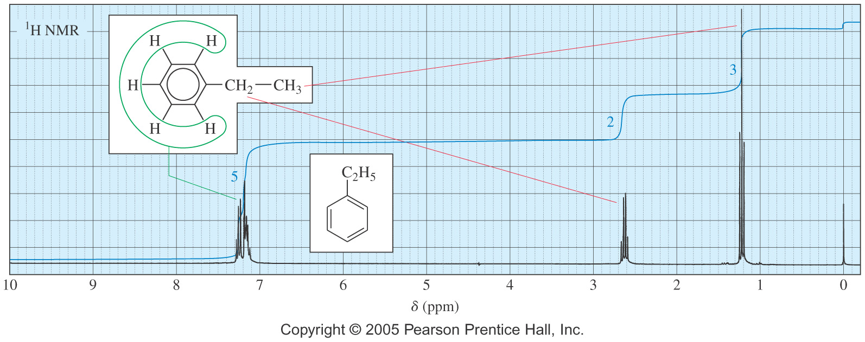
SPIN-SPIN COUPLING

Slide 38
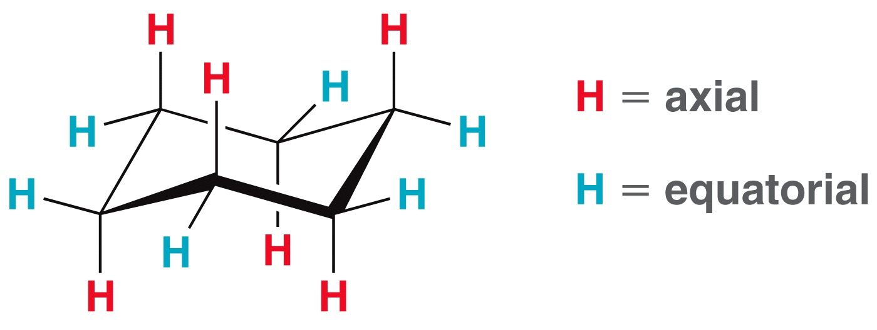
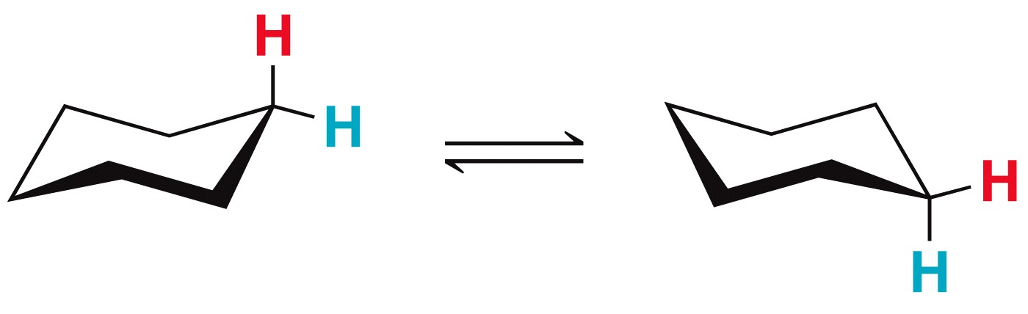
SPIN-SPIN COUPLING
Predict the number of signals expected, their splitting, and their relative area in the ¹H NMR spectrum

Slide 39

SPIN-SPIN COUPLING
Some Coupling Constants values

Slide 40
SPIN-SPIN COUPLING
Equivalent protons do not split each other.
Protons bonded to the same carbon will split each other only if they are not equivalent.
Protons on adjacent carbons normally will couple.
Protons separated by four or more bonds will not couple

Slide 41
VARIANCE DEPENDING NMR
Protons on oxygen, nitrogen and sulfur
Protons directly bonded to an oxygen, nitrogen or sulfur atom behave very differently from protons bonded to carbons.
They are exchangeable
They are subject to hydrogen bonding
Those on nitrogen (¹⁴N) atom are subject to a partial or complete decoupling by the electrical quadrupole moment of the ¹⁴N nucleus
Protons on oxygen
Depending on the concentration, the hydroxylic proton in alcohols is found between 0.5 and 5 ppm.
The change in temperature and the polarity of the solvent also affect their chemical shift.
Hydrogen bonding decreases the electron density around the proton, thus moving its signal to higher frequency, especially in carboxylic acids
Rapid exchangeability explains why the hydroxylic proton in alcohols appear as a singlet

Slide 42


VARIANCE DEPENDING NMR
Protons on oxygen
The rate of exchange can be decrease by lowering the temperature or by drying the solvent (anhydrous sodium carbonate, alumina or grade 3A or 4A molecular sieves).
For example, ultrapure samples of ethanol show splitting. Ethanol with a small amount of acidic or basic impurities will not show splitting
Purified, dry deuterated DMSO or deuterated acetone used as solvent, in addition to allowing a lower rate of exchange, shifts the signal for the hydroxylic proton to the left through hydrogen bonding with the solvent.

Slide 43
VARIANCE DEPENDING NMR
Protons on oxygen
Carboxylic acids exist as stable hydrogen-bonded dimeric units in non polar solvents even at high dilution. The carboxylic proton therefore absorbs in a characteristic narrow range (δ 13.2 ~ 10.0 ppm).
Protons on nitrogen
The protons bonded to nitrogen may undergo a fast, intermediate or a slow exchange
When the exchange is fast, the NH proton(s) is decoupled from the N atom and the protons on the adjacent carbons, and thus appears as a sharp singlet.
When the exchange is intermediate, the NH proton signal is broadened either because of a partial decoupling or as a result of the electrical quadrupole moment.
However, the protons bonded to the nitrogen atom in ammonium salts exchange at a slower rate. They are observed as a broad peaks (δ 6.0 to 8.5 ppm), and they couple with the protons on the adjacent carbon(s).

Slide 44
VARIANCE DEPENDING NMR
Protons on Sulfur
Sulfhydryl protons usually exchange at a low rate so that at room temperature they are coupled to protons on adjacent carbon(s) (J = 8 Hz).
They do not exchange rapidly with hydroxyl, carboxylic, or enolic protons on the same or other molecules either, thus separate signals are observed.
Axial and equatorial protons on cyclohexane interconvert so rapidly that they give a single signal.

Slide 45
COMPLEX SPIN-SPIN COUPLING
Coupling Constants
Coupling constant is a distance between the peaks of multiplet, it is measured in Hz, and is not dependent on strength of the external field.
Multiplets with the same coupling constants may come from adjacent groups of protons that split each other
Signals may be split by adjacent protons, different from each other, with different coupling constants.
Example: Hª of styrene is split by the adjacent trans H^{b} (J = 17 Hz) and the adjacent H^{c} cis (J = 11 Hz) to yield a doublet of doublet instead of a triplet.
Practice 16.15 P. 756

Slide 46



COMPLEX SPIN-SPIN COUPLING
¹H-NMR spectrum of styrene

Slide 47

GEMINAL NONEQUIVALENT PROTONS
Practice 16.11 to 16.13 P. 752, 16.21 P.763, 16.23 P. 767
Problem 16.51 to 16.56 P. 777-778, 16.62 to 16.71 P 779-780
Examples
Deduce the identity of the following compounds from the ¹H NMR data given.
C₉H₁₀O₂: δ 2.2 (3H, singlet), 5.0 (2H, singlet), 7.2 (5H, multiplet) (ppm)
2. C₅H₈Cl₂: (δ): 1.4 (4H, t), 1.2 (4H, t) ppm
3. C₆H₈O₄: δ 3.9 (6H, singlet), 6.1 (2H, singlet) (ppm)
4. C₉H₉N; IR (cm-1):3050, 2950, 2240, 1630
¹H NMR (d): 7.5 (2H, d), 7.1 (2H, d), 2.3 (2H, q), 0.9 (3H, t) ppm

Slide 48
CARBON -13 (¹³C) –NMR
The isotope of carbon with seven neutrons (¹³C) composes about 1.1% of carbon atoms and is NMR active
About 99% of the carbon atoms in a natural sample are the isotope ¹²C which has no magnetic spin (even number of protons and even number of neutrons).
Carbon NMR signals are much weaker than proton signals (The gyromagnetic ratio of ¹³C is one-fourth of that of ¹H), and signals can get lost in the noise. Thus, hundreds of spectra are taken and averaged
Differences in ¹³C Technique
Resonance frequency is ~ one-fourth, 75 MHz instead of 300 MHz.
Peak areas are not proportional to number of carbons.
Carbon atoms with more hydrogens absorb more strongly
It is unlikely that a ¹³C would be adjacent to another ¹³C, so splitting by carbon is negligible.
¹³C will magnetically couple with attached protons and adjacent protons.
These complex splitting patterns are difficult to interpret

Slide 49

¹³C-NMR CHEMICALS SHIFTS
Off-Resonance Decoupling
¹³C nuclei are split only by the protons attached directly to them.
The N + 1 rule applies: a carbon with N number of protons gives a signal with N + 1 peaks

Slide 50


¹H-NMR AND ¹³C-NMR CHEMICALS SHIFTS
Practice 16.25 to 16.27 P. 769
Problem 16.38, 16.39 P. 776,

Slide 51
MAGNETIC RESONANCE IMAGING
When Chemists use NMR, they place small tubes of homogeneous solutions in the magnetic field. Their goal is to have the sample behave as if it were all at the same external magnetic field.
Nuclear magnetic resonance imaging uses the same physical effect, but its goal is almost the opposite of chemical NMR.
In magnetic resonance imaging, a heterogeneous sample (human body) is placed in the magnetic field of a large-bore super-conducting magnet.
The magnetic field is uniform, with a gradient that allows just protons in one plane of the sample to be in resonance at any one time. Using a combination of field gradients and a sophisticated Fourier transform techniques, the instrument can examine selectively one point within the sample, a line or a plane within the sample (noninvasive).

Slide 52

MAGNETIC RESONANCE IMAGING
The computer generate a series of two dimensional slices which, when accumulated, give a three dimensional plot of the proton within the bulk of the sample
MRI image can easily distinguish watery tissues, fatty tissues, bone, air spaces, bloods, etc…
Tumors are readily detected
MRI scan of a human brain showing a metastatic tumor in one hemisphere

